Slide 1
Preparations for Instructor
Three premade paper airplanes on colored paper
Lots of white paper
Paper clips & Ruler
Scissors (optional)
Glue stick (optional)
Stapler (optional)
Coloring instruments (markers, crayons…) (optional)
Tape (optional)

Slide 2
Agile Developer | Agile Developer | Waterfall Developer | Waterfall Developer
Agile Designer | Agile Designer | Waterfall Designer | Waterfall Tester
Agile Tester | Agile Tester | Client Implementer | Client Implementer
Client Implementer | Camera Handler | Off the Shelf Buyer | Off the shelf Developer
Off the shelf Developer | Waterfall Tester
Notes:
Instructor can print out and cut out and hand out so students can remember what they are. Aim for a balanced set of participants.

Slide 3
 | Off the shelf Developer | Off the Shelf Buyer | Client Implementer
Waterfall Designer (x1) | Waterfall Developer (x2) | Waterfall Tester (x2) | Client Implementer
Agile Designer (x2) | Agile Developer (x2) | Agile Tester (x2) | Client Implementer
Notes:
Instructor can print out and cut out and hand out so students can remember what they are. Aim for a balanced set of participants.

Slide 4
Software Development Lifecycle
IS201 – 3 February 2020 – Prof Redd

Slide 5
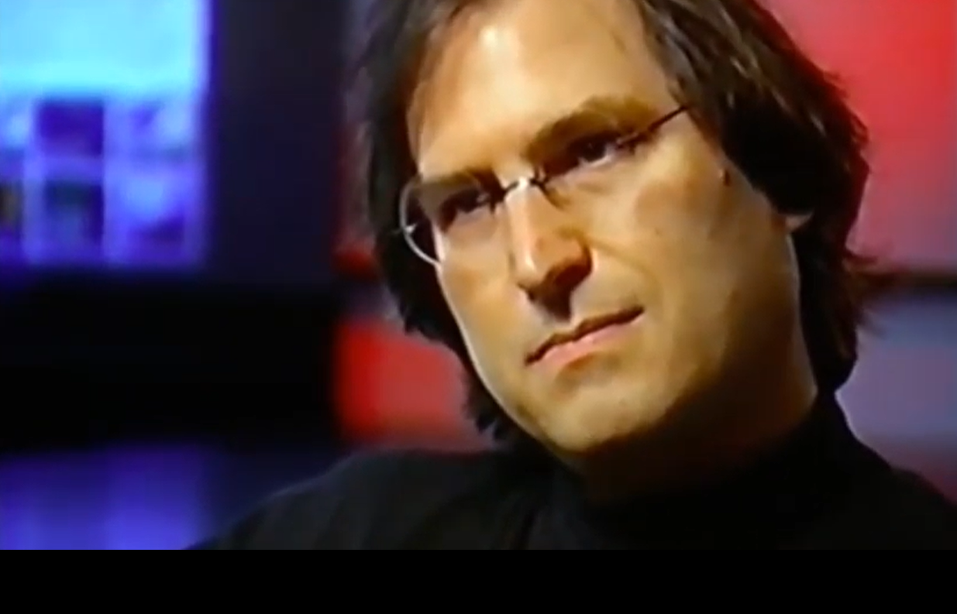
Steve Jobs on Product Development
1995
https://www.youtube.com/watch?v=7JmXAzByGVg

Slide 6
Developing Information Systems The Systems Development Life Cycle (SDLC) and Project Management
I, the Lord God, created all things, of which I have spoken, spiritually, before they were naturally upon the face of the earth.
Moses 3:5
1

Slide 7
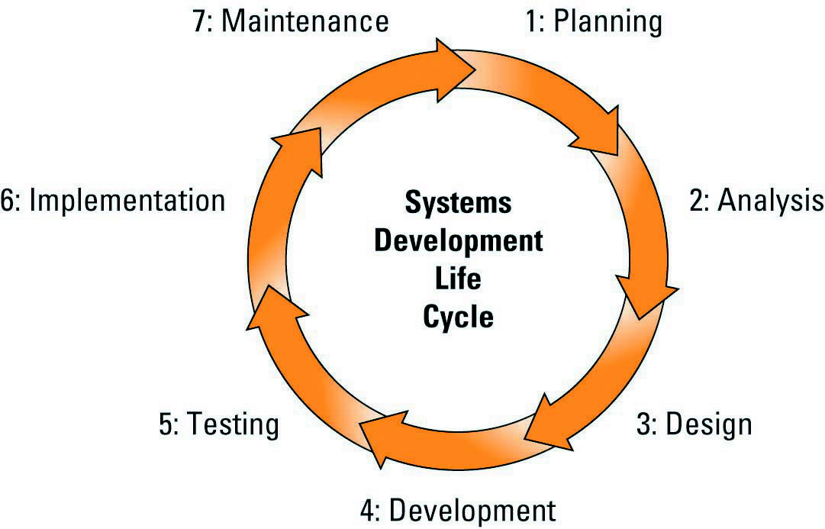
The Systems Development Life Cycle SDLC

Slide 8

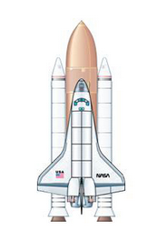
Apollo Missions as System Development Projects
How can we extend its useful life?
Should/can we do this?
Does it work in practice?
What are the requirements?
Does it work in the lab?
What will it look like (front end and back end)?
1966-2012
$200+ Billion
Let’s make it!
9

Slide 9
Many factors stimulate system changes:
changing government regulations
problems in the current IS
customer (market) demands
employee suggestions
management requests
corporate growth, expansion, acquisition
changing business/industry
changing technology
competitive pressures
branding issues
productivity requirements
new liabilities and risks
wear and tear
…………
4

Slide 10
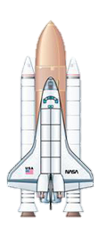
Project management constraints
Quality
You want | You get
Less TIME | Less SCOPE, More COST
Less COST | Less SCOPE, More TIME
More SCOPE | More TIME, More COST
Time
Cost
Scope
Notes:
These three variables are interdependent
You cannot change one without changing the others
For example, decreasing a project’s timeframe means either increasing the cost of the project or decreasing the scope of the project to meet the new deadline
Increasing a project’s scope means either increasing the project’s timeframe or increasing the project’s cost – or both – to meet the increased scope changes
Project management is the science of making intelligent trade-offs among time, cost, and scope

Slide 11
System Development Methodologies
Waterfall
“Cascades” linearly through the 7 phases
Agile (i.e. “quick” & “flexible”)
Small projects delivered quickly & frequently; daily collaboration with users
Rapid Application Development (RAD)
Rapid prototyping; interactive user involvement
Extreme Programming (XP) Methodology
Tiny manageable phases; iterate with user feedback
Commercial off the shelf
Buy a ready made solution (e.g., SalesForce CRM)
D&C 60:5 "Let there be a craft made, or bought, as seemeth you good, it mattereth not unto me."
11

Slide 12
Planning
Analysis
Design
Develop
Test
Implement
Maintain
Notes:
Because external things (requirements, regulations, technologies) change during the SDLC.

Slide 13

Some practical application

Slide 14
PLANNING
Should we do this? (yes; otherwise we will not learn today…)
Decide on Team
Project Manager – Prof Redd
Customer Representatives – all students
Waterfall Team
Five students – 1 designer, 2 developers, 2 testers
Agile Team
Six students – 2 designers, 2 developers, 2 testers
Off the Shelf Team
1 buyer – 1 developer
Client implementers – 3 students

Slide 15
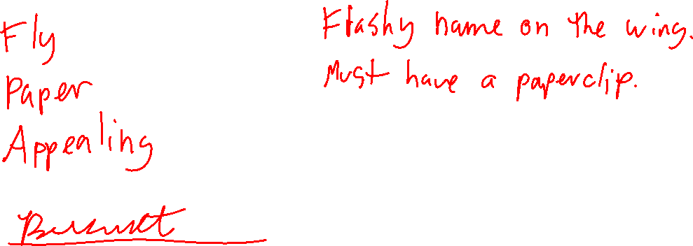
ANALYSIS
What are the requirements?
Notes:
I like to do this one in Google Polls when I have a large class.

Slide 16

Off the Shelf – Time to buy
Notes:
Let the student off the shelf rep come and select a prefabricated airplane. They can test it out and compare it to the requirements document.

Slide 17
WATERFALL
Design
Develop
Test
(Be back in 5-10 minutes)

Slide 18
AGILE – DESIGN
Designers find existing design solution that best fits new requirements, if any
Adjust existing design according to new requirements

Slide 19

President demands planes must display a flashy name on wing
Add to Requirements Document

Slide 20
AGILE – DEVELOP
Agile developers build planes from new designs
Designers continue to design better planes

Slide 21
TSA requires all planes have paper clips
Add to Requirements Document

Slide 22
AGILE – TEST
Agile testers test new planes on stage
Designers continue to design
Developers continue to develop

Slide 23
AGILE – WRAP UP
Designers, developers and testers adjust according to test results.

Slide 24
IMPLEMENTATION!!!
Three implementers come on down
Evaluate planes against final requirements document
Execute implementation (throw planes from launch site)

Slide 25
Waterfall
Planning
10% Success Rate
(90% FAILURE Rate)
Analysis
Design
Stage Gates
Develop
Test
Why?
Because of Exogenous Change
Implement
Maintain
Notes:
Because external things (requirements, regulations, technologies) change during the SDLC.

Slide 26
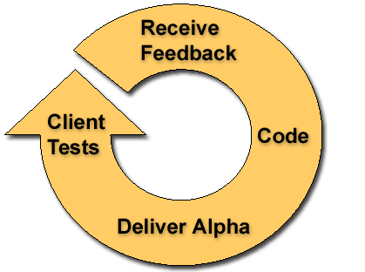
Agile
Planning
Analysis
Design
Develop
Test
Implement
Sometimes multiple cycles per day
Maintain

Slide 27
Commercial off the shelf
Planning
Analysis
Design
Develop
Test
Implement
But the commercial product probably used agile development internally.
Maintain

Slide 28
Real World: Agile Smarter Balanced Assessment Consortium
Consortium that produces assessments for 12 states (Summative and Interim)
RFP (Request for Proposal) to develop a custom assessment item authoring and banking system.
$750,000 and 18 months.
MVP (Minimum Viable Product) in 9 months. Constant feedback from customers/users.

Slide 29
Real World: Off-The-Self ELPA21 – UCLA
Produces English Language Proficiency Tests for approx. 10 states.
Needs an assessment item authoring and banking system
Doesn’t have $750K or 18 months
Off-the-shelf purchase (governed by California procurement law)
Requirements development
Survey of available products
Gap analysis (difference between requirements and available products)
Vendor qualification
Custom enhancement
Implementation

Slide 30
Phase 1: Planning
Select the system project
Assess project feasibility
Produce Project plan (Project Management)
Assign Team members, Develop Schedule (milestones)
Choose methodology (off the shelf, Waterfall, Agile)

Slide 31

Feasibility Assessment
Economical
Do benefits exceed costs? (e.g. ROI)
Technical
Is technology available - are we up to it?
Operational
Can our organization operate it?
Legal
Does it meet all regulations and laws?
Scheduling
Is the implementation schedule practical? Have we allowed time to build, test, train, etc.?

Slide 32
Phase 2: Systems Analysis (What must the system do to meet the objectives?)
Collect/Analyze Data: Study the current system
Determine business / customer requirements
Write requirements definition document
Sign Off

Slide 33
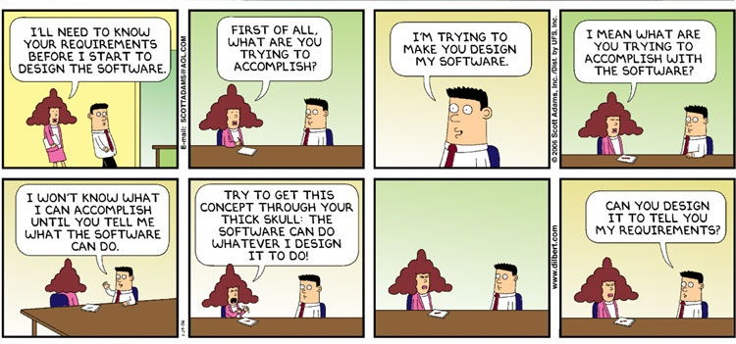
Click to reveal
Notes:
Comic strip

Slide 34
Phase 3: Systems Design
Design the IT infrastructure
Hardware
Software
Design the System Components (details)
Screen layouts; reports; procedures
Program logic
Database structure (data models/ERDs)
Notes:
Discuss briefly

Slide 35
Phase 4: Development
Structure & Build the databases
Write the programs
Physical Implementation
Construct the physical infrastructure (power, AC, etc.)
Purchase/Install Hardware and Software
Notes:
Discuss briefly

Slide 36
Phase 5: Testing
Develop test conditions
Types of Testing
Unit – Does the component work as specified?
Application/System – Will components work together?
Backup/Recovery – Will it restart after disaster or failure?
Documentation – Are instructions accurate and helpful?
Integration – does it work with other systems?
Regression – are other functions still working?
User Acceptance Test (UAT) – Does the system satisfy user needs?
Notes:
Discuss briefly

Slide 37
Phase 6: Implementation
Steps in the Systems Implementation Phase:
Complete detailed user documentation
Choose the conversion method (next slide)
Prepare users (train on new system)
Convert/start new system
Get user acceptance
Usually users resist (HATE) change
Notes:
Discuss briefly

Slide 38
Implementation approach (Conversion)
Direct
Switch from the old system to the new one “overnight”
Parallel
Avoids some risk; run the old system until the new one is working
Phased
Activate a new system one module at a time
Pilot
Activate and test the new system in one branch of an organization

Slide 39
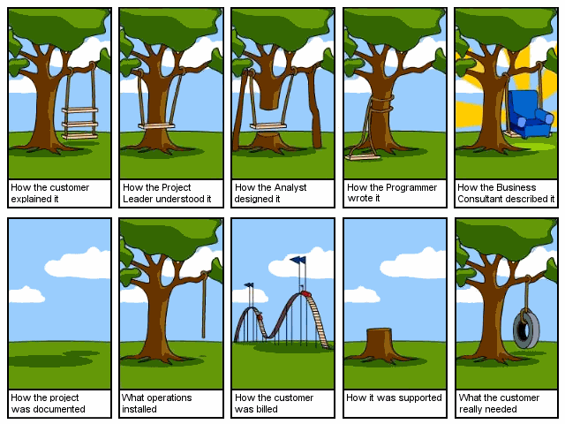
Click to reveal
Notes:
Comic strip

Slide 40

Phase 7: Maintenance
Steps in System Maintenance:
Implement backup procedures
Help users, fix problems, optimize
Negotiate additional features
Technical support
Carefully Manage Change:
Change Control Board (CCB)
Also part of implementation

Slide 41
Maintenance is HUGE!
IS modifications consume a significant share of IS department resources.
fix bugs
add new features
deal with new versions of vendor software (compatibility)
Some IS organizations spend 70% (or more) of their IS budget on system maintenance.

Slide 42
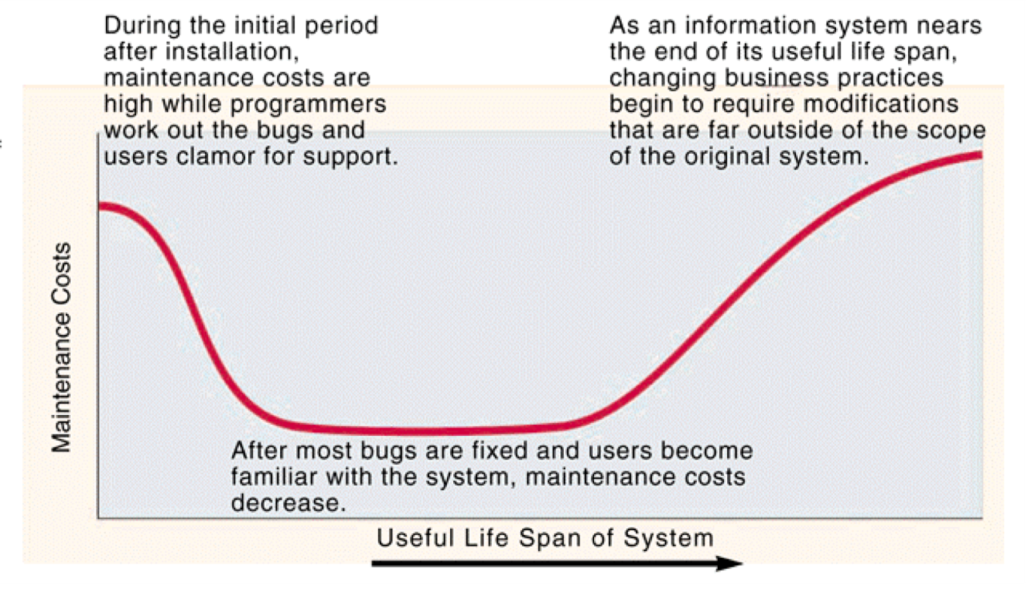
Maintenance Cost Pattern

Slide 43


The SDLC Circle of Life
Notes:
Once a system has used up its useful life, it is time to start SDLC all over again.

Slide 44
Reasons for Systems Development Problems
Important Business Requirements Unclear or Missing
Skip SDLC Phases
Failure to Manage Project Scope
Poor project management
Changing Technology
These principles apply to all kinds of projects – NOT only to Information Systems.

Slide 45
Principles of Successful Development
Keep the Budgets small (costs only increase)
If it doesn’t work, kill it (“but we’ve already spent so much..”)
Keep requirements to a minimum (scope only grows)
Test and Deliver Frequently (don’t go too far down the wrong path)
Assign Non-IT execs to software projects (they see differently)
Ask the “dumb” questions (“will customers even use this?”)

Slide 46
Job roles involved with the SDLC
Systems Analyst
Systems Designer/ Architect
Systems Programmer
Project Manager
CIO
…and many others…
https://www.indeed.com/jobs?q=Systems+Analyst&l=Salt+Lake+City%2C+UT

